Slide 1
Handwritten Text Recognition system
Ashraqat Sheta (13)
Fatma Ibrahim (42)

Slide 2
Problem Statement
The Accuracy of the model is need to be improved:-
3/4 of the words from the validation-set are correctly recognized and the character error rate is around 10% from the IAM dataset

Slide 3
solution
We will take a part of Dataset and apply training on it to evaluate the difference modifications
Studying the effect of trying different variations of CNNs architecture
Replace LSTM by GRU
Replace optimizer by Adam

Slide 4
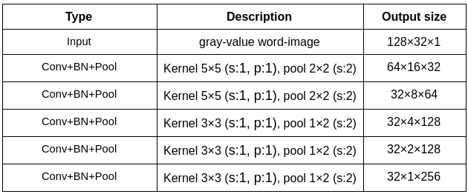
Trying different variations of CNNs architecture
Current Model CNN Architecture:-
5 CNN layers map the input image to a feature sequence of size 32x256, Each layer consists of three operation. the convolution operation, the non-linear RELU function is applied and a pooling layer

Slide 5
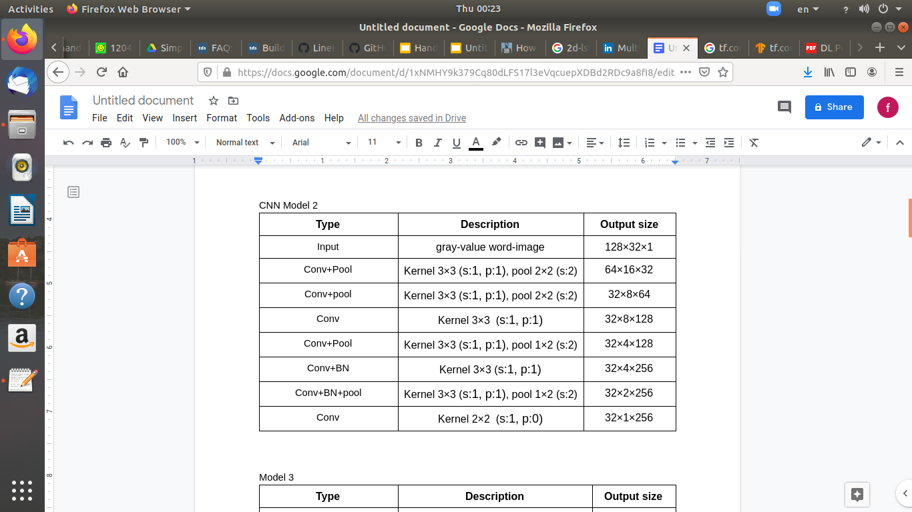
Different CNN model [1]:-
7 CNN layers map the input image to a feature sequence of size 32x256, the layers consist of convolution, pooling and non linear Relu layers . and uses batch normalization in two layers.

Slide 6
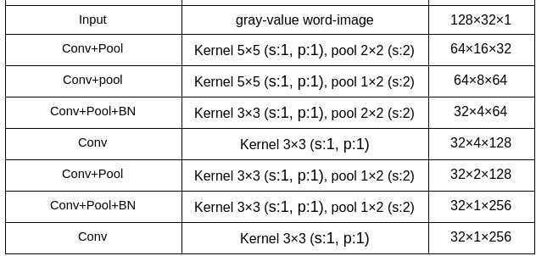
Different CNN model [2]
7 CNN layers map the input image to a feature sequence of size 32x256, the layers consist of convolution, pooling and non linear Relu layers .and uses batch normalization in two layers.

Slide 7
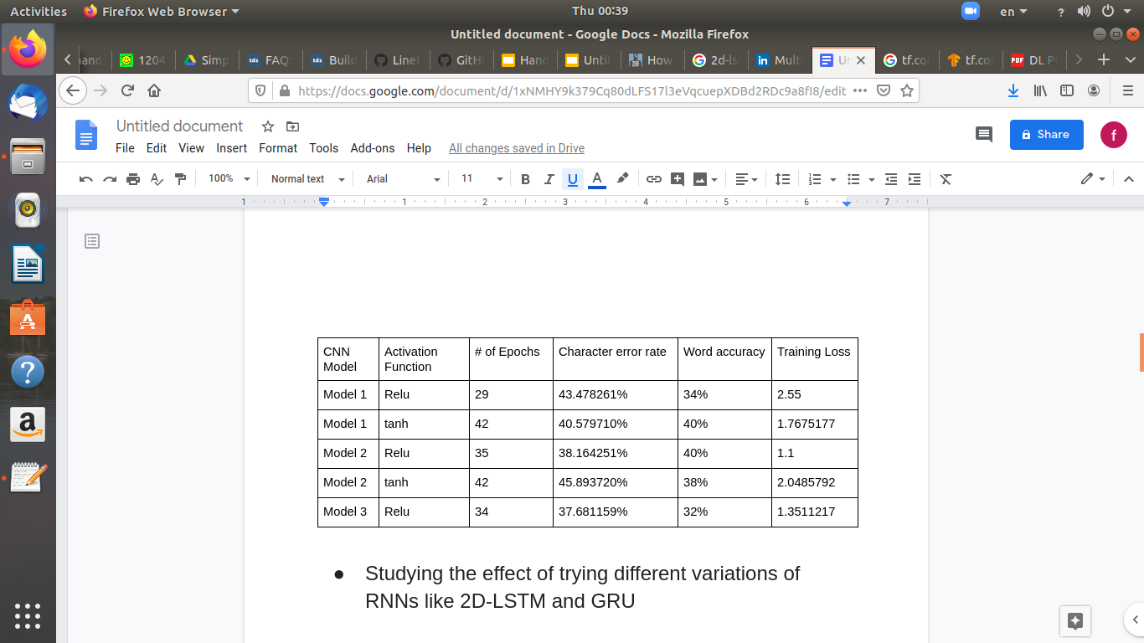
The evaluation results between differents CNN architecture
Model 2 with non linear Relu layers got the best result among other architecture.

Slide 8
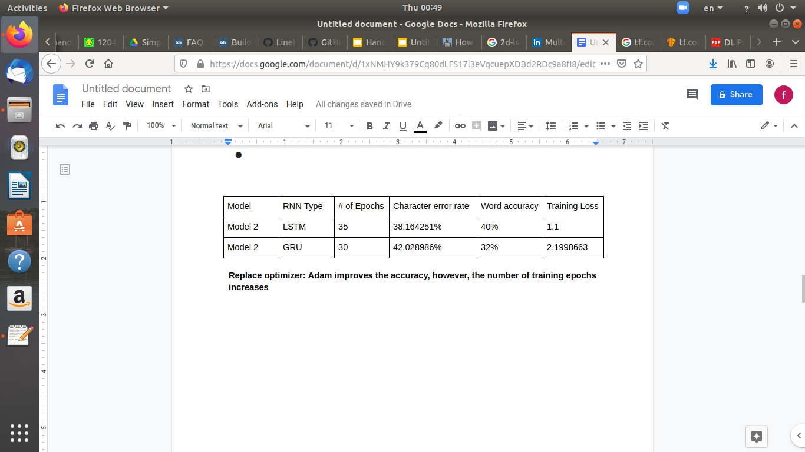
Evaluation Results By Replace LSTM By GRU
LSTM is better than GRU

Slide 9
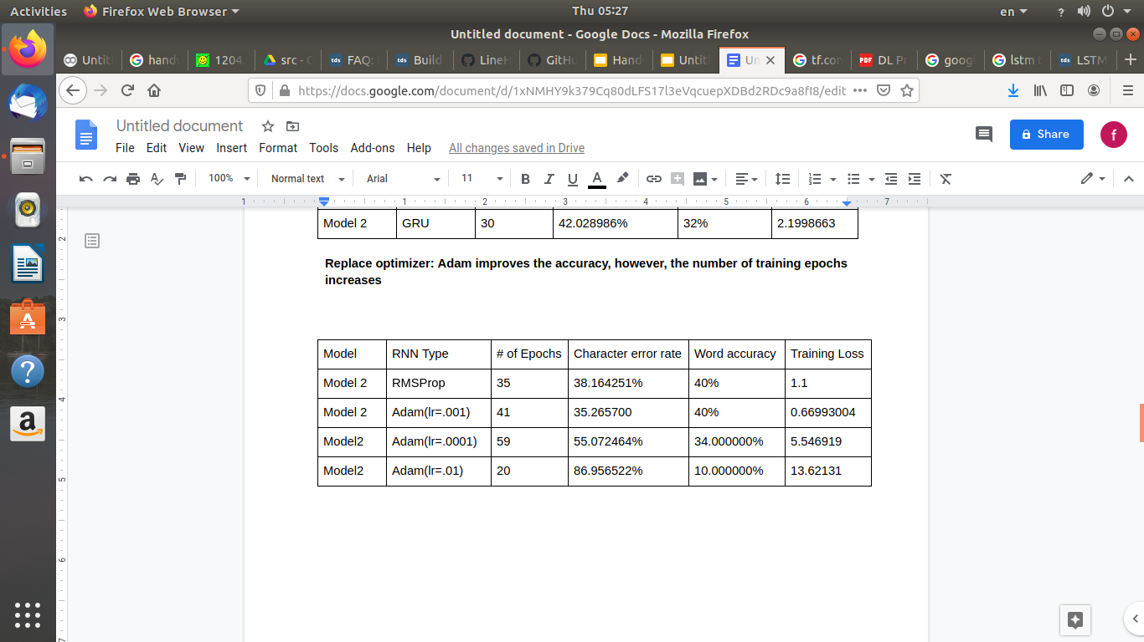
Replace Optimizer by Adam
Adam improves the accuracy, however, the number of training epochs increases

Slide 10
the evaluation difference between the original model and our solution.
Original Model:-
Number of epochs:-38
New Model:-
Number of epochs:-27

Slide 11


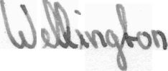
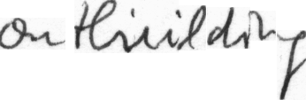



 | Original Model |  | Proposed Model
Test Word | Recognized | probability | Recognized | probability
 | nature | 0.8632938 | nature | 0.94406354
 | probably | 0.9635818 | probably | 0.971316
 | Wilingston | 0.16331485 | Wilington | 0.4085443
 | outhiucilding | 0.02816745 | onthiilding | 0.06953326
 | strengthened | 0.9247407 | strengthened | 0.8108373
 | poblem | 0.66334456 | poblem | 0.2755211
 | Secretary | 0.46566343 | Secretary | 0.6599404

Slide 12







 | Original Model |  | New Model
Test Word | Recognized | probability | Recognized | probability
 | 1sithromyain | 0.08430587 | Azithromycin | .08566643
 | Amoxicillin | 0.2829 | Amoxicilin | 0.57535
 | ferrous | 0.8913 | ferrous | 0.6843
 | sulrate | 0.3366 | sulfate | 0.6429
 | Prenobarbital | 0.20474869 | Plenbarbita | 0.0073939087
 | Pentetn | 0.0009623823 | Penerton | 0.0010430847
 | pigmintaa | 0.005072847 | pigmicntgn | 0.0026469224

Slide 13
Conclusion
According to previous modifications the accuracy of the model hasn’t been widely exchanged, the model need to be trained over a medical dataset.
it’s better to use spell corrector.
Future work.
Extend model to fit complete text-lines
OCR POST-PROCESSING ERROR CORRECTION ALGORITHM

Slide 14
References
[1] Convolutional Recurrent Neural Network (CRNN)
[2] Handwritten Text Recognition inHistorical Documents

